Slide 1
HARMS PHARMACY MANAGEMENT SYSTEM
GROUP MEMBERS :
Akula venkata sai aditya B200820CS
Karanam hema bhargavi B200776CS
Mamidipalli rishita B200778CS

Slide 2
REQUIREMENT ANALYSIS:-
We can use a Pharmacy management system for saving time, manipulating,and working on data of Pharmacy medical products. This helps to minimize time consumption, manpower, and paperwork while working on pharmacy products. PMS also helps to store data in a secure way and for easy billing.
The PMS is built in order to replace manual based system to computerize. Pharmacists use computerized systems only for billing but this PMS is also useful for pharmacists to know where the drug is kept and about its stock. For pharmacists, it is difficult to remember the arrangement of drugs on the shelf and they do not have any efficient method for arranging medicine on the shelf with a manual-based system. This PMS provides an easy way to find a drug on the shelf just by entering drug details. Also provides security and easy manipulation of pharmacy databases.

Slide 3
PMS can do the following :-
Store Pharmacy product data
Search Pharmacy product data effectively
Update, Delete, and Edit Pharmacy product information
Generate report on Pharmacy product
Prepare bill for customer buying
Security for data
Gives alert when Pharmacy product is low and or when it is expired.
Provides information for customers on Pharmacy products .
Can be able to change login credentials easily.
Can open Employee and Manager working webpages separately.
The pharmacy management system operates the queries in a small amount of time (in seconds) and it can be accessed by many users at a time or concurrently.

Slide 4
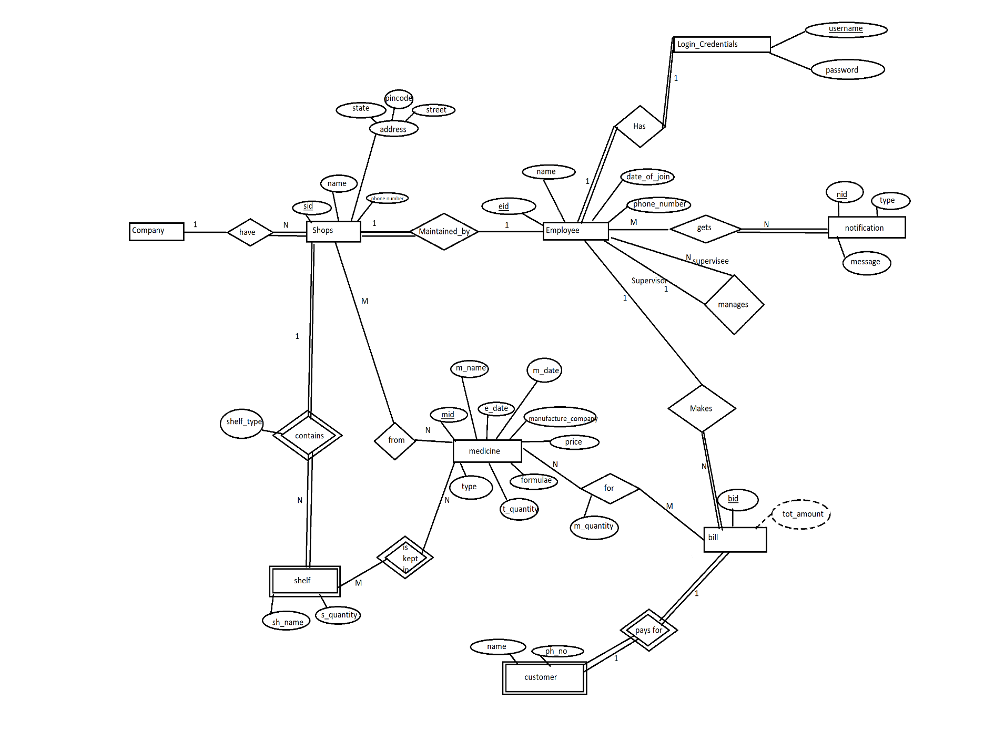

Slide 5
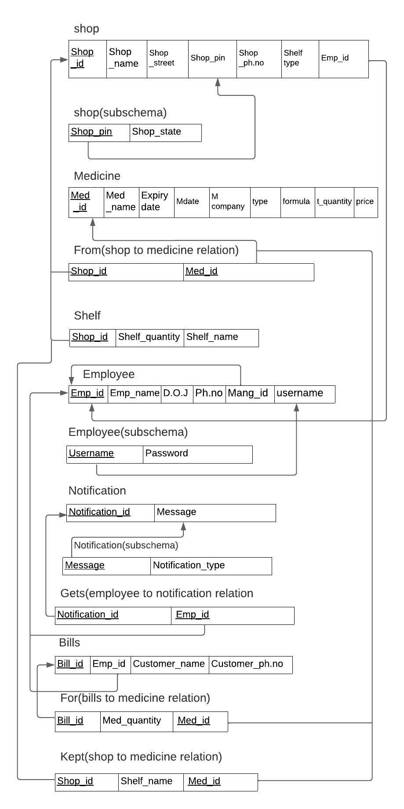
ASSUMPTIONS TO PMS:-
PMS deals with only one company and medical shops owned by that company.
Customers are not regular
Assigning only one employee to one shop
All shops are maintained by a single manager.
CARDINALITY AND PARTICIPATION:-
Company to Shop → 1:n
Shop to Shelves → 1:n
Shop to Employee → 1:1
Shop to medicine → m:n
Medicine to Shelves → m:n
Employee to Bills → 1:n
Medicine to Bill → m:n
Bill to Customers → 1:1
Employee to Notification → m:n
Employee to Login → 1:1

Slide 6
IMPLEMENTATION:-
FRONTEND:-Used HTML,CSS
BACKEND:-Used PHP
DATABASE CREATION:-Used XAMPP server and created Database using SQL
FOR ER AND RELATIONAL SCHEMA: EDRAW MAX
→Separated entities , attributes and relationships for PMS and designed ER diagram and relational schema
→Assumed Functional dependencies then normalised relational tables and using Xampp server created database for obtained relational schema after normalisation
→Inserted data of PMS into database using SQL
→Created rough sketches of interfaces for frontend
→Based on created interfaces using HTML , CSS designed frontend for PMS
→Using PHP connected frontend and Database of PMS
→Checked final outputs of PMS website by comparing with data in database.

Slide 7
1. First interface
Select whether you are a customer or employee
2. If you are a CUSTOMER,
Customer interface opens,
By entering medicine name and selecting location customer can search for required medicine availability and details about that medicine from stores in selected location.
3. If you are an EMPLOYEE
Employee interface opens and asks for his credentials.
If he entered correct credentials he can login into his working page and do his works like
i. Sending notification to manager
ii. Medicine searching in shelves, update shelves and take medicine out of shelves
iii. Billing
Here we can create bill with details of medicines bought by customer. We also added a search option here to search for medicine price and details if needed.

Slide 8
iv. Add a shelf to the Shop
We can divide the shelves already present in shop and name the newly created shelf to add new medicines into it.
v. Shop sales
Here Pharmacist can see details about all the medicines present in shop along with quantity of medicines sold and quantity of medicines left
vi. Change password
here pharmacist can change his login credentials if he wanted to change
4.If you are a MANAGER:-
Manager interface open and he can login into his page by entering his login credentials correctly .He can do works like:
i. Notifications
Here manager can see the notifications send by the pharmacist which have details about the medicines that are expired or in low stock
ii. Medicine
here manager can add a new medicine to the database and manipulate medicines like he can add any particular medicine to the banned list and also he can update the details of any medicine if needed

Slide 9
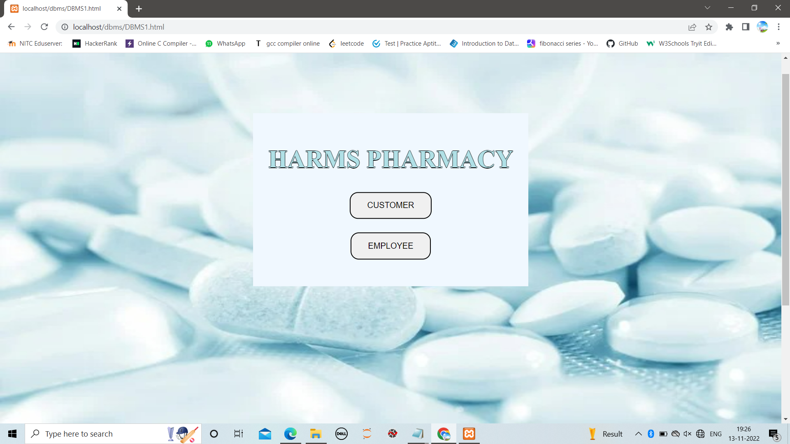
iii. Generate report
Here manager can see all the details of the medicines of any medicine present in the database including the details of manufactured and expired dates and that medicine is banned lor not
iv. Shop management
Here manager can increase medicine quantities for any medicines in any shop present in database , he can also add new medicines of required quantity to any particular shop , he can get details of all medical shops present in a choosen location and he can also gets shop reports
v. Change password
Here manager can change his login credentials if needed
TESTING AND DEMO:-
First Interface:-

Slide 10
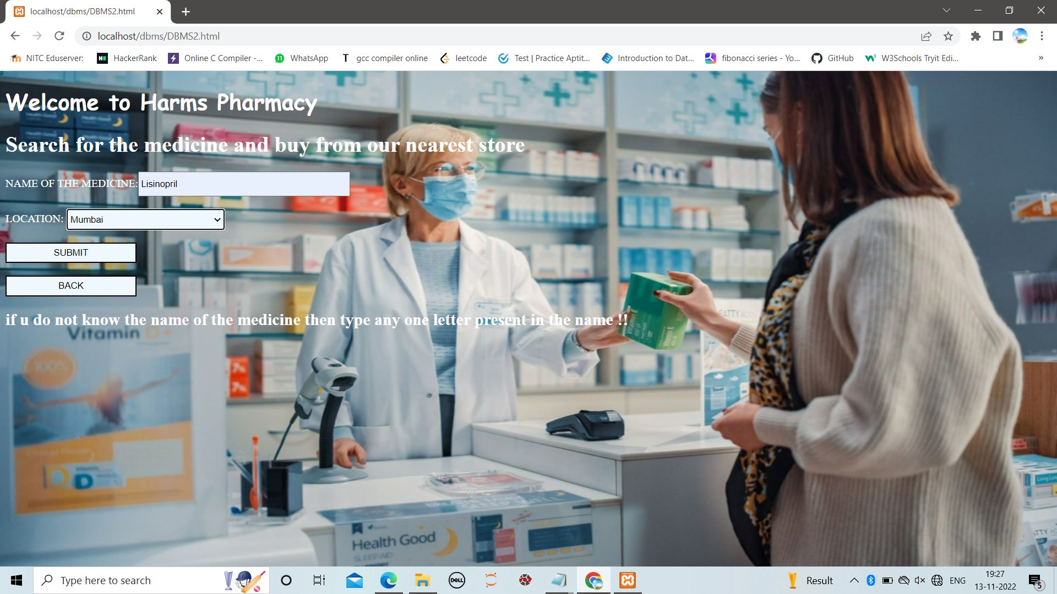
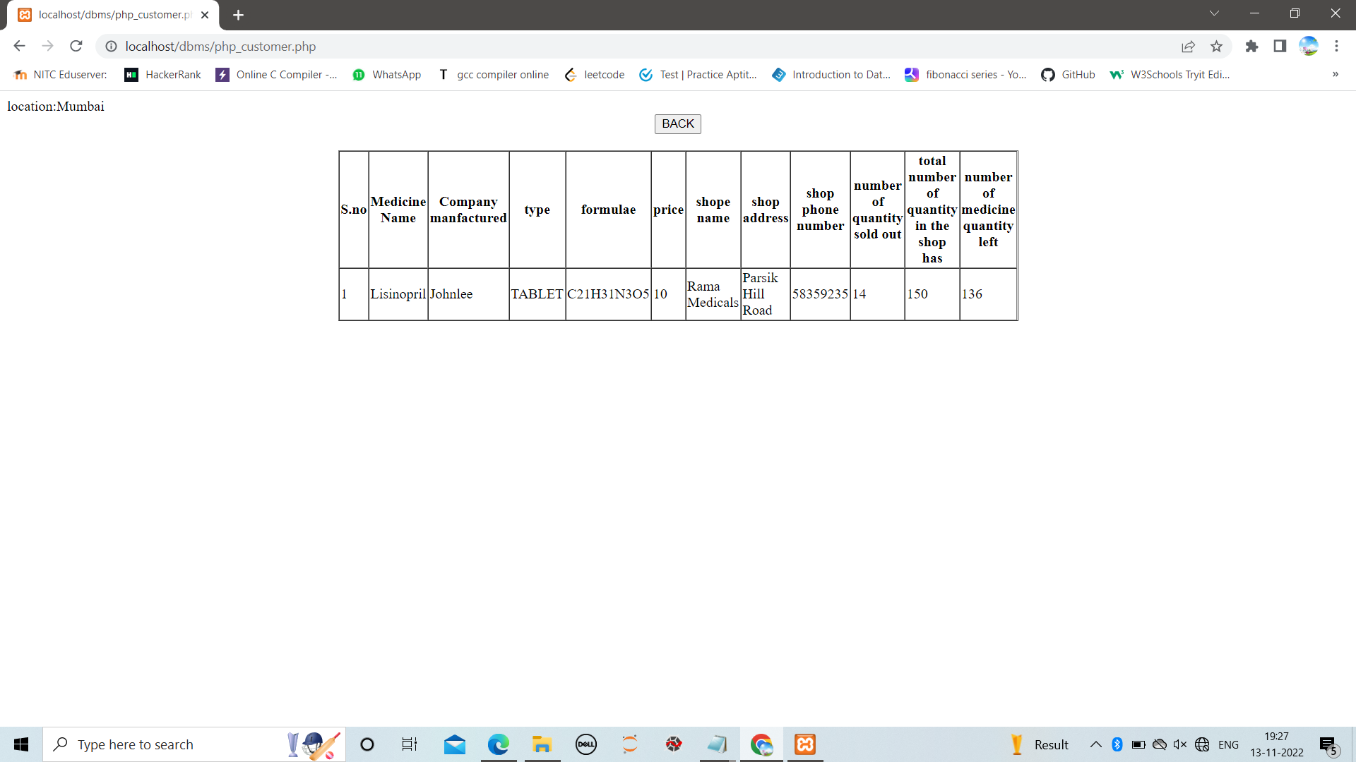
CUSTOMER INTERFACE:-

Slide 11
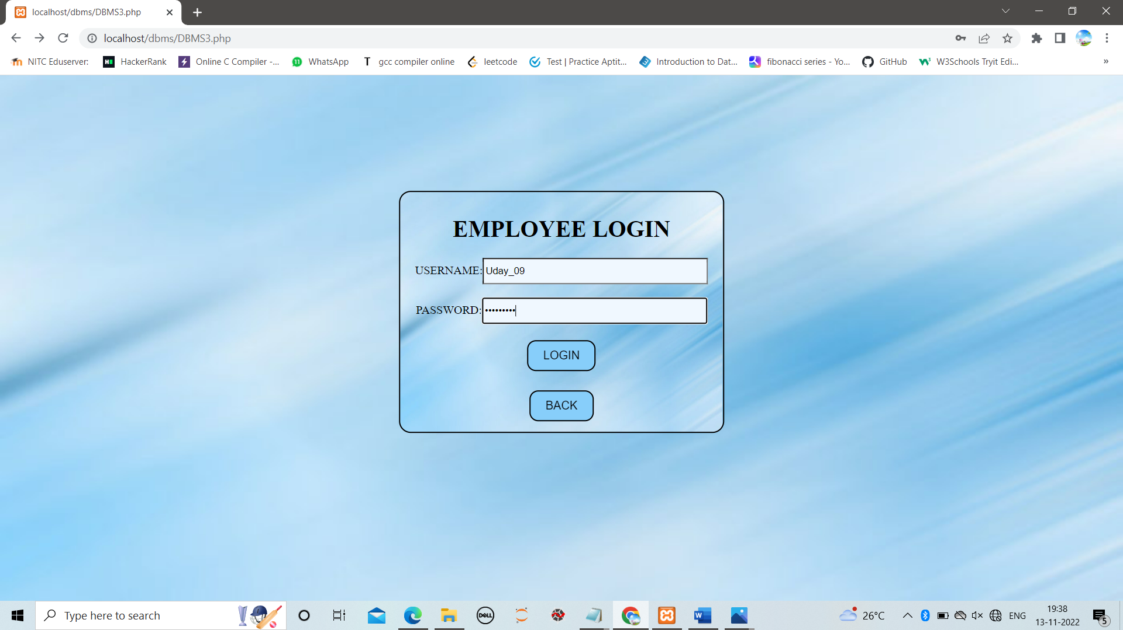
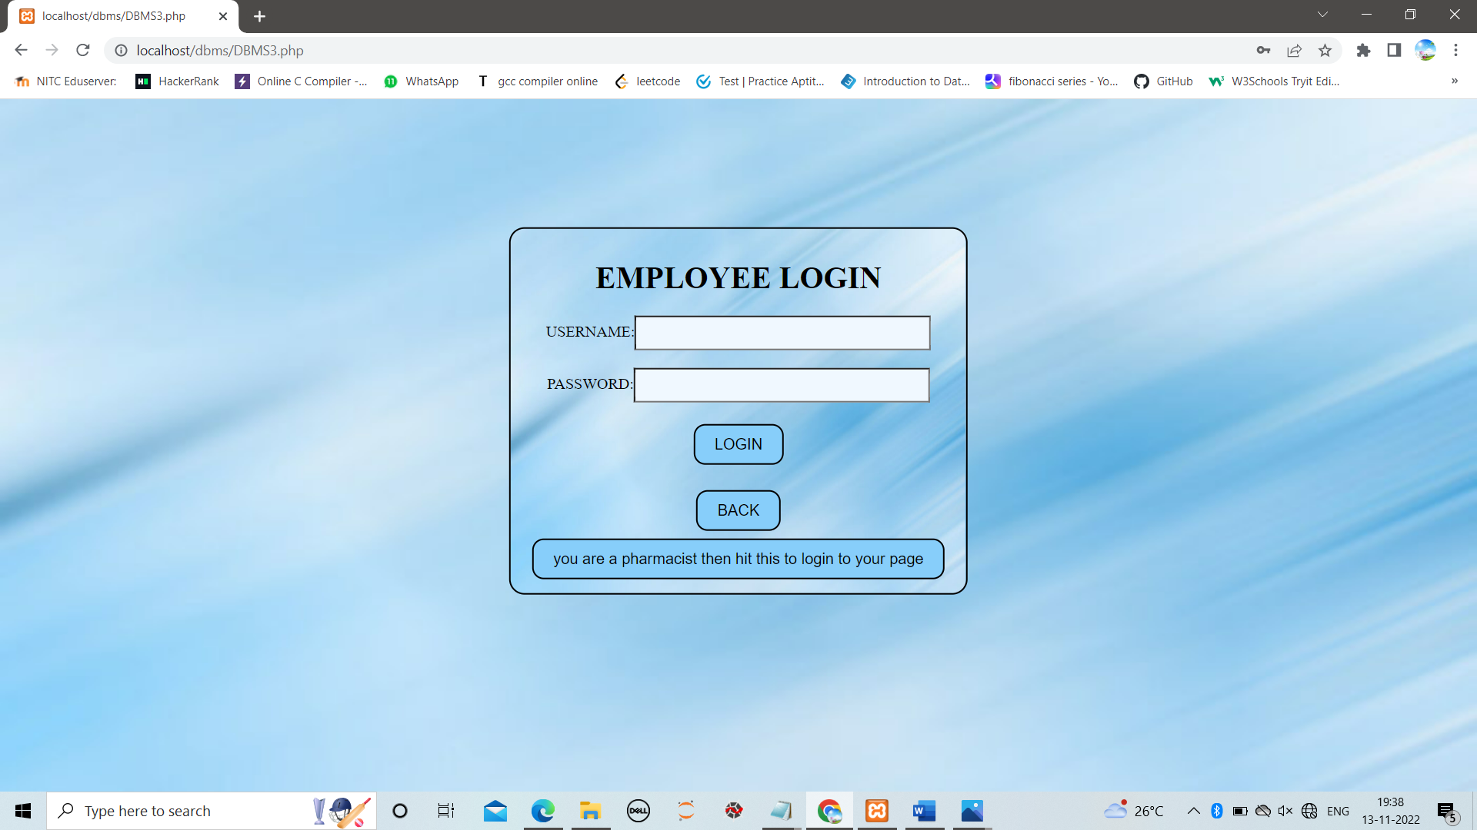
EMPLOYEE INTERFACE:-
If he is an employee opens pharmacy interface page otherwise opens manager interface page.

Slide 12
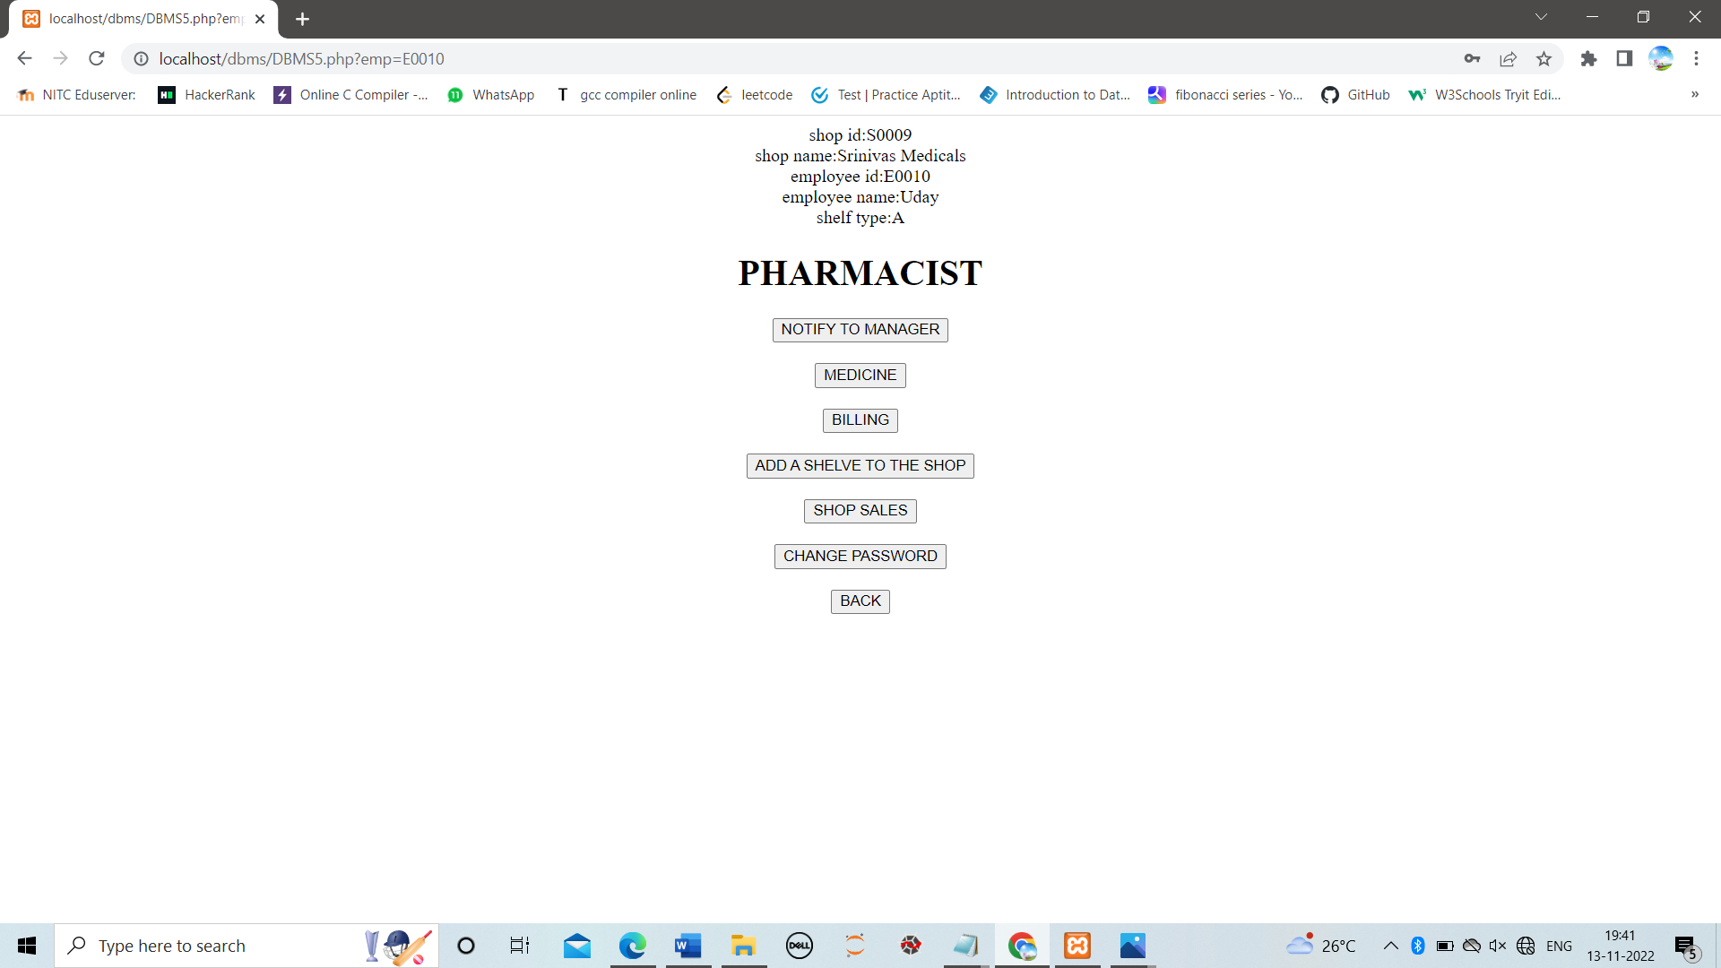
In employee interface :
After an employee entered his credentials correctly then he can see all the details of the shop in which he is working
Here when Uday a pharmacist entered his login
credentials correctly he can see all the details of the
shop in which he is working along with works
he can perform
NOTIFY TO MANAGER:-
Just by clicking on it he can add auto generated
information about expired and low stock medicines
to manager notifications.
MEDICINE:-
When an pharmacist is searching for any medicine in his shop he
can enter id and name in this page and get its details.
Generally Pharmacist work is to arrange medicines in shelves,
from here he can get into shelf arrangement and updating
arrangement

Slide 13
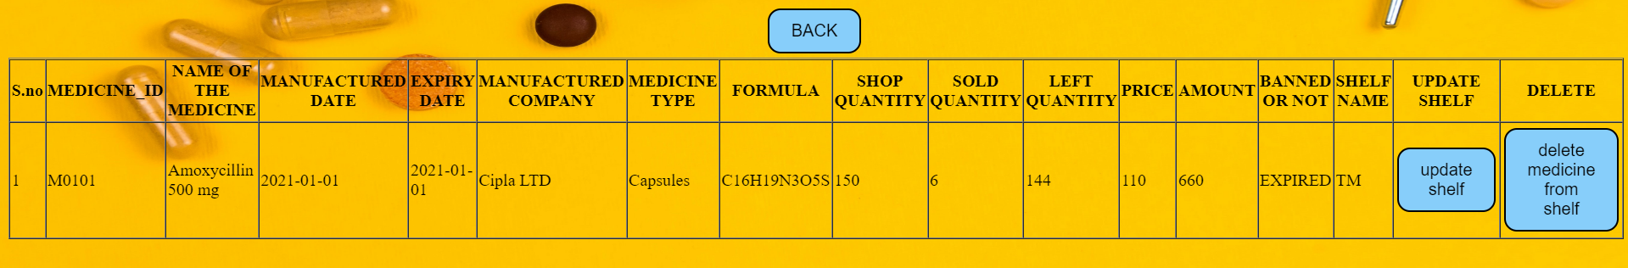
He can get all the details of any medicine present in shop
4 . Submitting the bill:
When an pharmacist enters the all the details of the medicines and prepares the bill
Then the our system automatically generates the final total bill and individual price for each medicine he can also delete particular medicine from a bill too

Slide 14
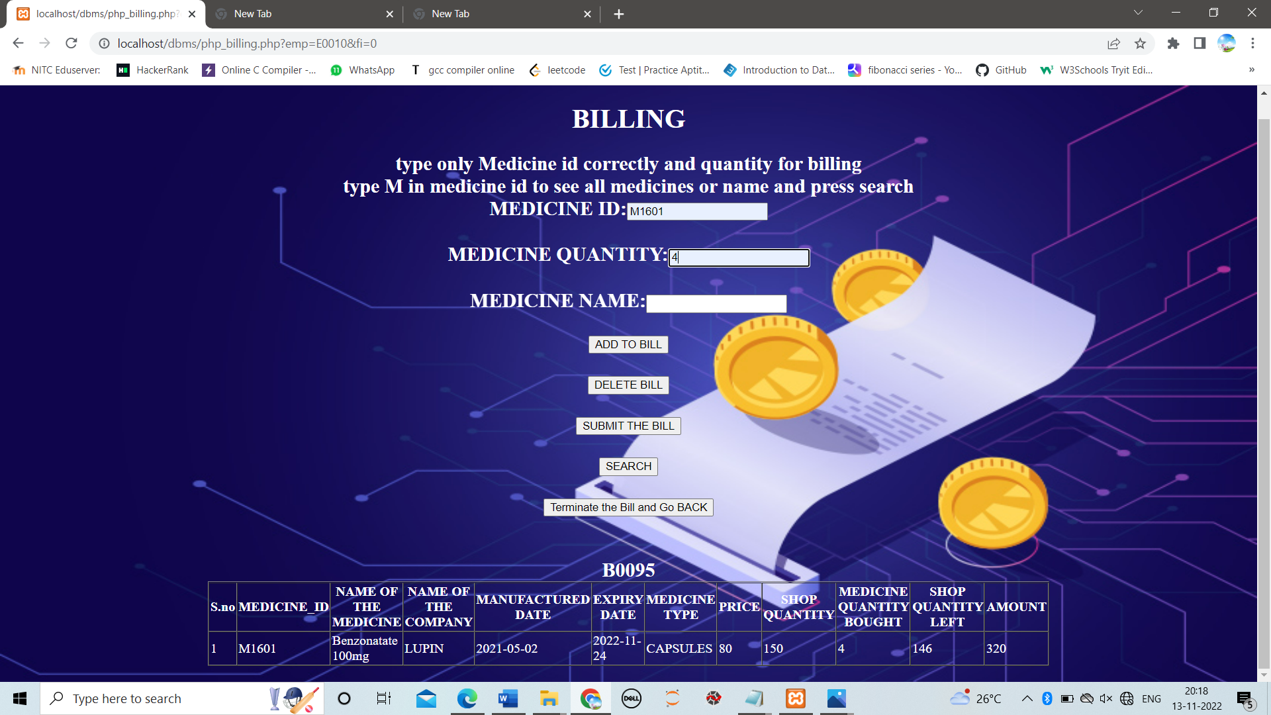
If customer wants to buy more than one medicine then enter each medicine individually and click on add to bill.
After that when we click on submit the bill pharmacist can get total bill of all the medicines after entering customer details

Slide 15
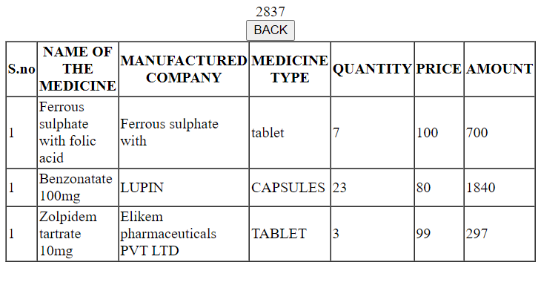
Here we can see the total bill at the top and individual prices for each medicine also
From all the above examples we can say that our PMS is working
properly for billing

Slide 16
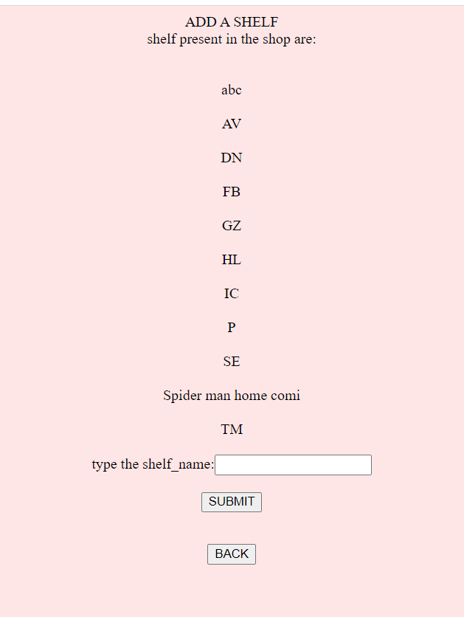
5. Add a shelf :
→ This interface is about adding new shelves in the Shop.
→ For we need to update the system
In this we have to enter the name of
the new shelf that we assigning in it
as per the name convention of the shop.
After that , when we click submit ,
a new shelf in updated into the shelves

Slide 17
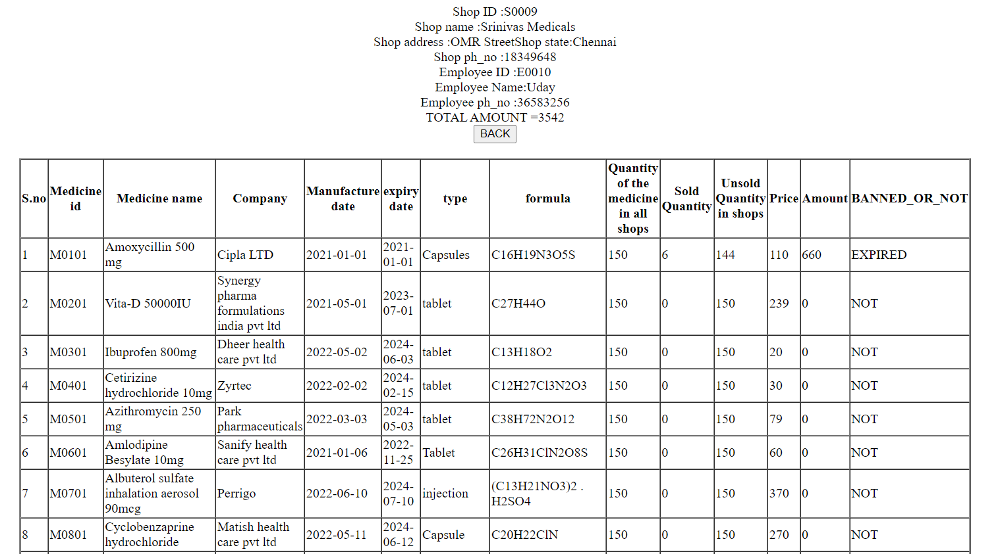
6. Generate a Report :
→ When a click on generate report then the shop sales of the corresponding shop will be given as shown in the below figure.

Slide 18
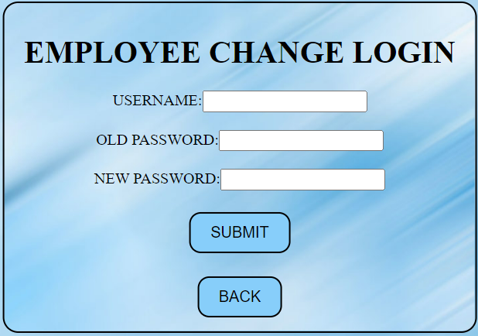
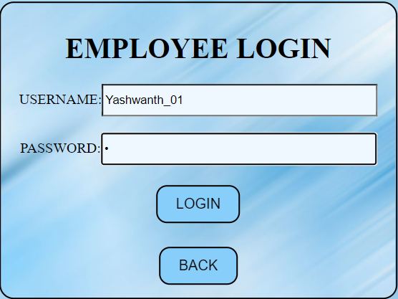
7. Change the Login Password :
→ Whenever an employee(same for the manager) tries to change the password.
→ Then they are supposed to give their login credentials and new password
MANAGER :
→ When the login credentials match with the manager,
then the interface of the manager will be opened.

Slide 19
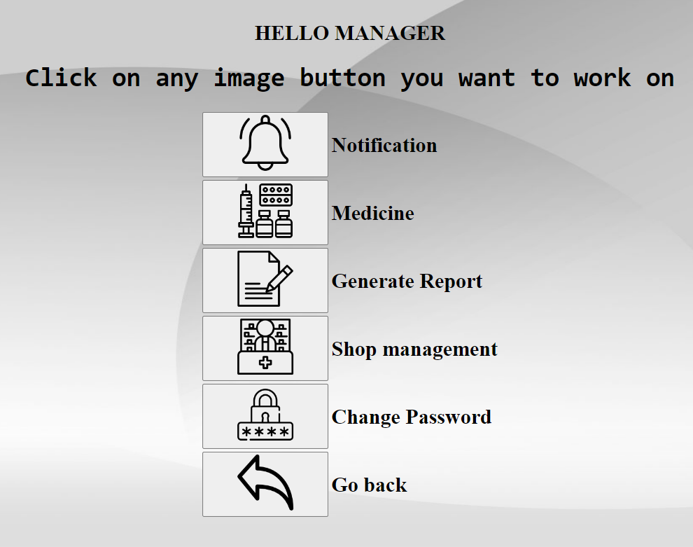
The interface of the manager contains all the operation , a manager can
do in the system

Slide 20
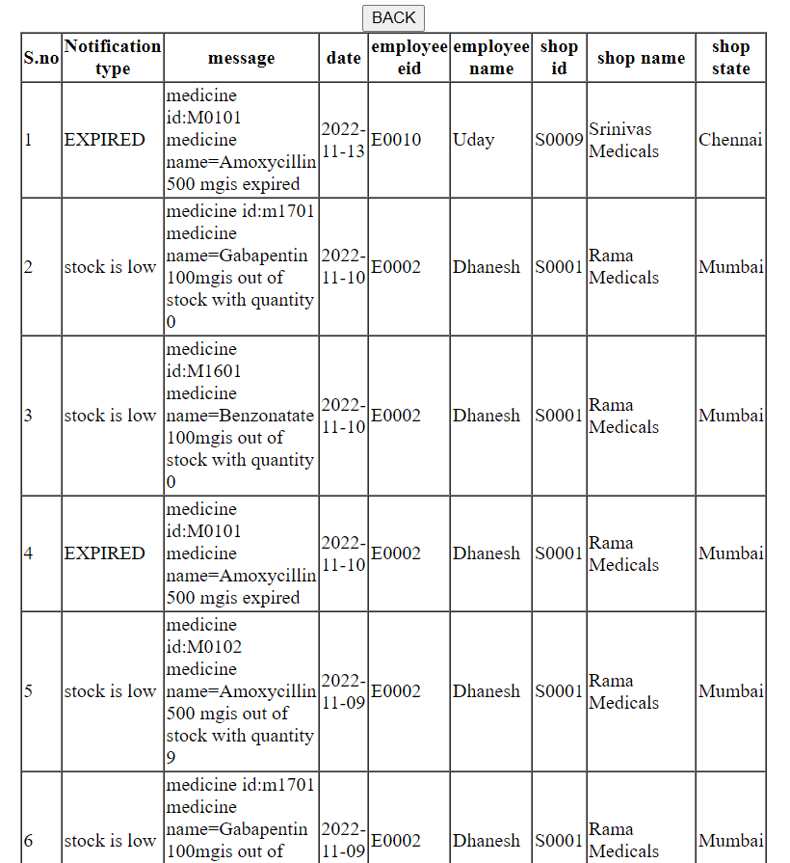
Notification :
→ This will give a complete information about the notifications, like what is
the notification , what does it notify

Slide 21
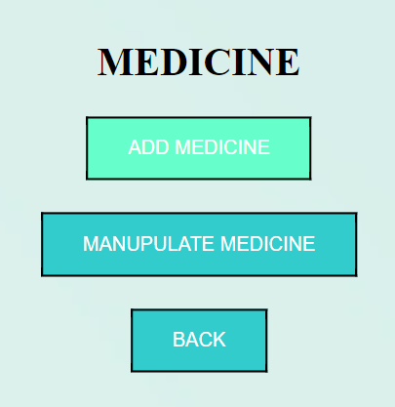
2. Medicine :
→ Through this ,the manager can access the data of the medicines.
i . Add medicine : Used to add a new medicine into the system by
giving the required details of the medicine.
ii. Manipulate Medicine : Used to change the data of the medicine.
→ This includes Banning a medicine.
→ For Expiry date of the medicine.
→ Update the details of the medicine.

Slide 22
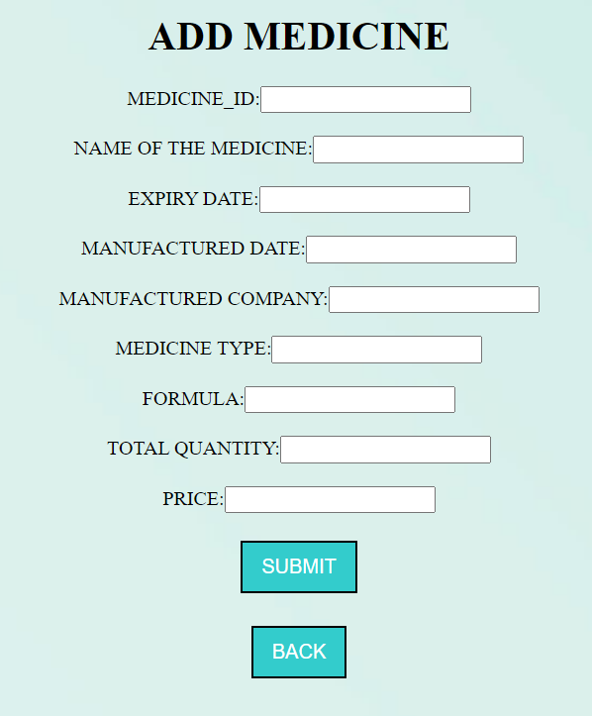
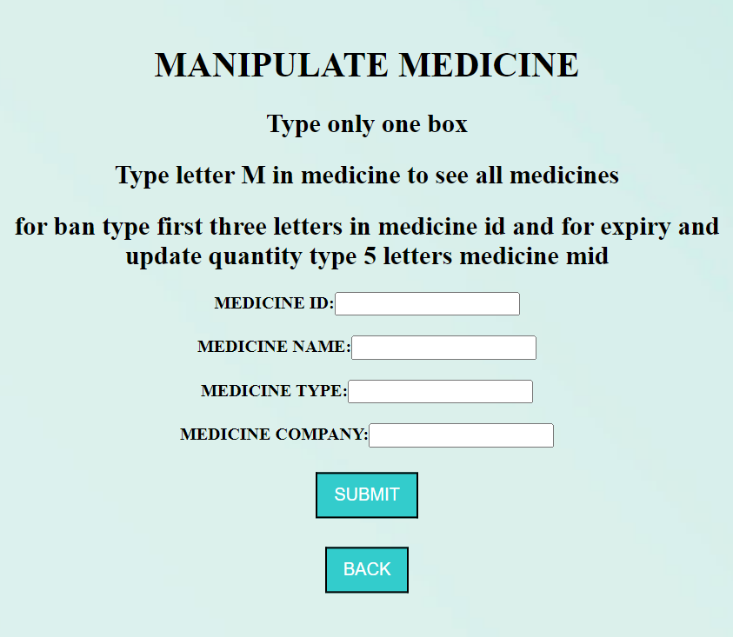
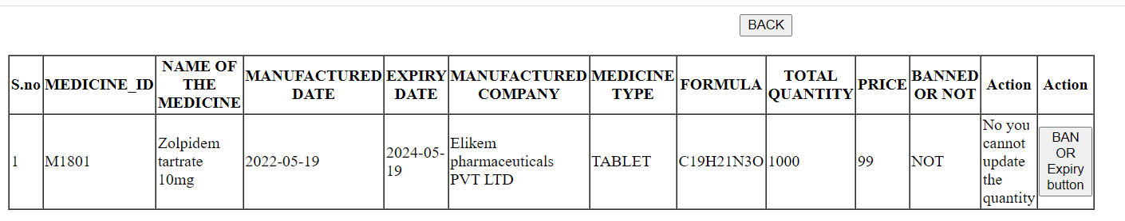
We can see the BAN or Expiry button in
the table below for manipulation.

Slide 23
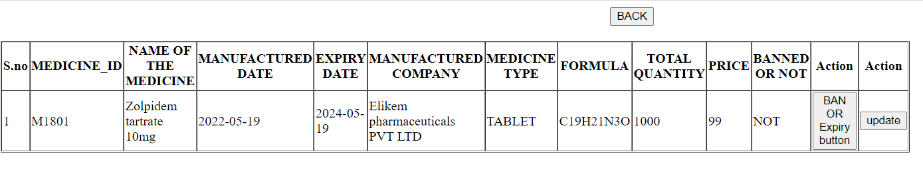
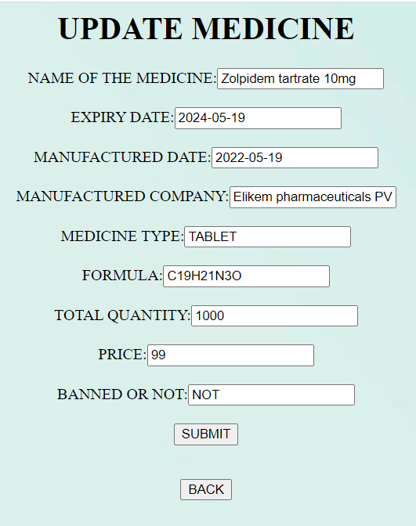
Upon the entry of the complete medicine ID as input will show an extra option,
update will be shown here.
On Clicking the update option,
An interface will be opened where you can
update the data of the medicine.

Slide 24
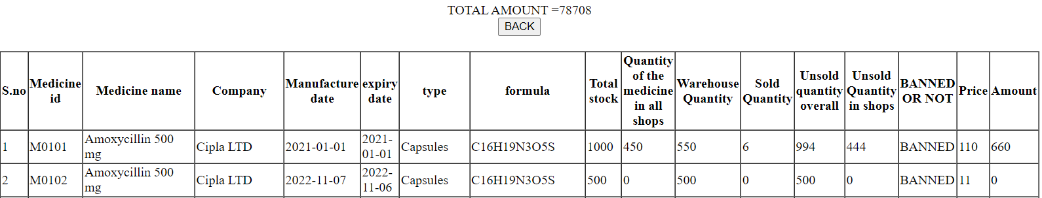
3. Generate Report :
→ In this the manager can see the complete data of the medicines with
the following details.
4. Shop management :
→ Through this , the manager will be able to manage the stock of
medicines in the shops
→ Firstly we have to select the state of the shop.
→ Then the system shows the information about the shops that are
present in that particular state.

Slide 25

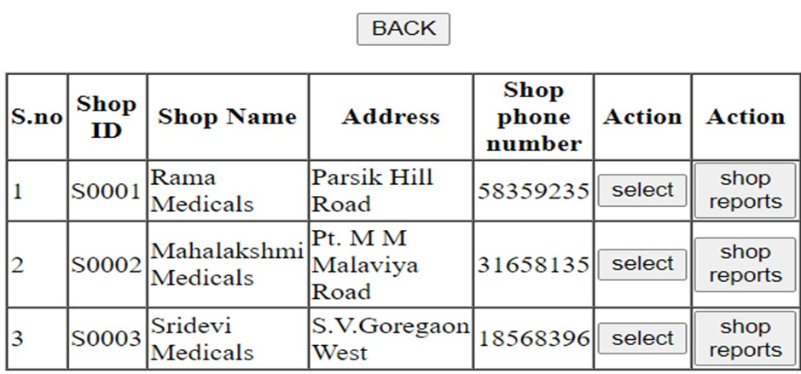

Slide 26
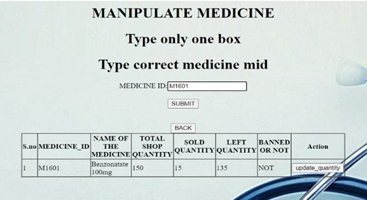
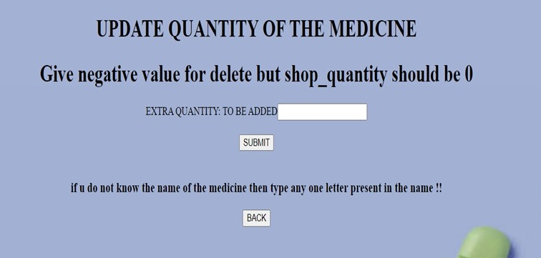
“Select” option :
it is for the updating the medicine quantity for a particular medicine.
Enter the amount of the medicine that to be added, After Submit it gets
updated

Slide 27
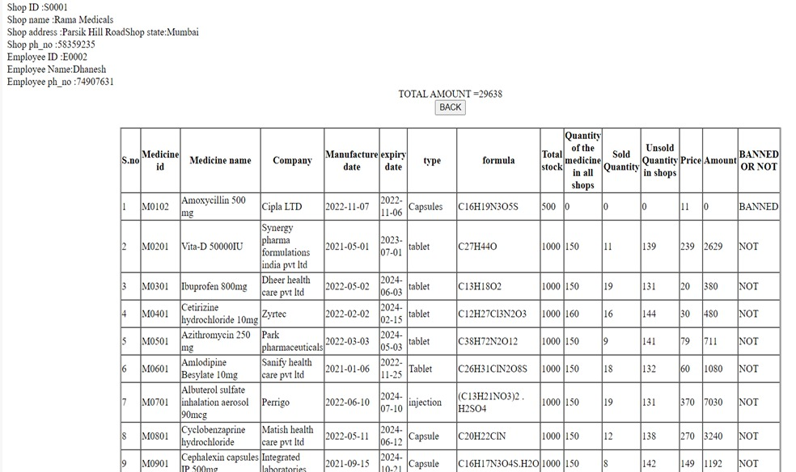
“Shop Reports” option :
This gives the information of the medicines that are present in that
particular shop as shown below.

Slide 28
CONCLUSION:-
→ PMS will solve the problem of the current system by minimizing time wastage and reduce resources which simply change manual based system to computerized system.
→It reduces paper work and man power.
→Generally Pharmacists use computerized systems only for billing but this PMS is also useful for pharmacists to know where the drug is kept and about its stock. For pharmacists, it is difficult to remember the arrangement of drugs on the shelf and they do not have any efficient method for arranging medicine on the shelf with a manual-based system. This PMS provides an easy way to find a drug on the shelf just by entering drug details.
→Also provides security and easy manipulation of pharmacy databases.
→Customer can also search for his required medicine
→Managers can login and manipulate data such as updating, adding new pharmacy products, and deleting products.
→PMS can perform all the stated works properly and efficiently and thus useful for a pharmacist and for pharmacy manager.

